Slide 1
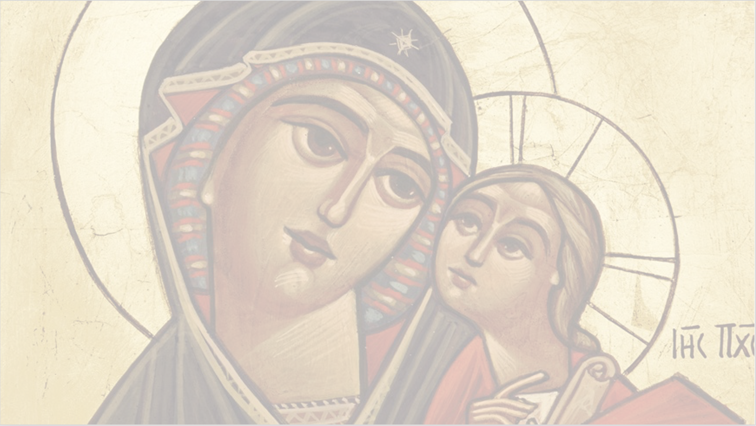
First Doxology for Koiahk
For when I speak about you,
O cherubic throne,
my tongue never wearies,
from blessing you.

Slide 2
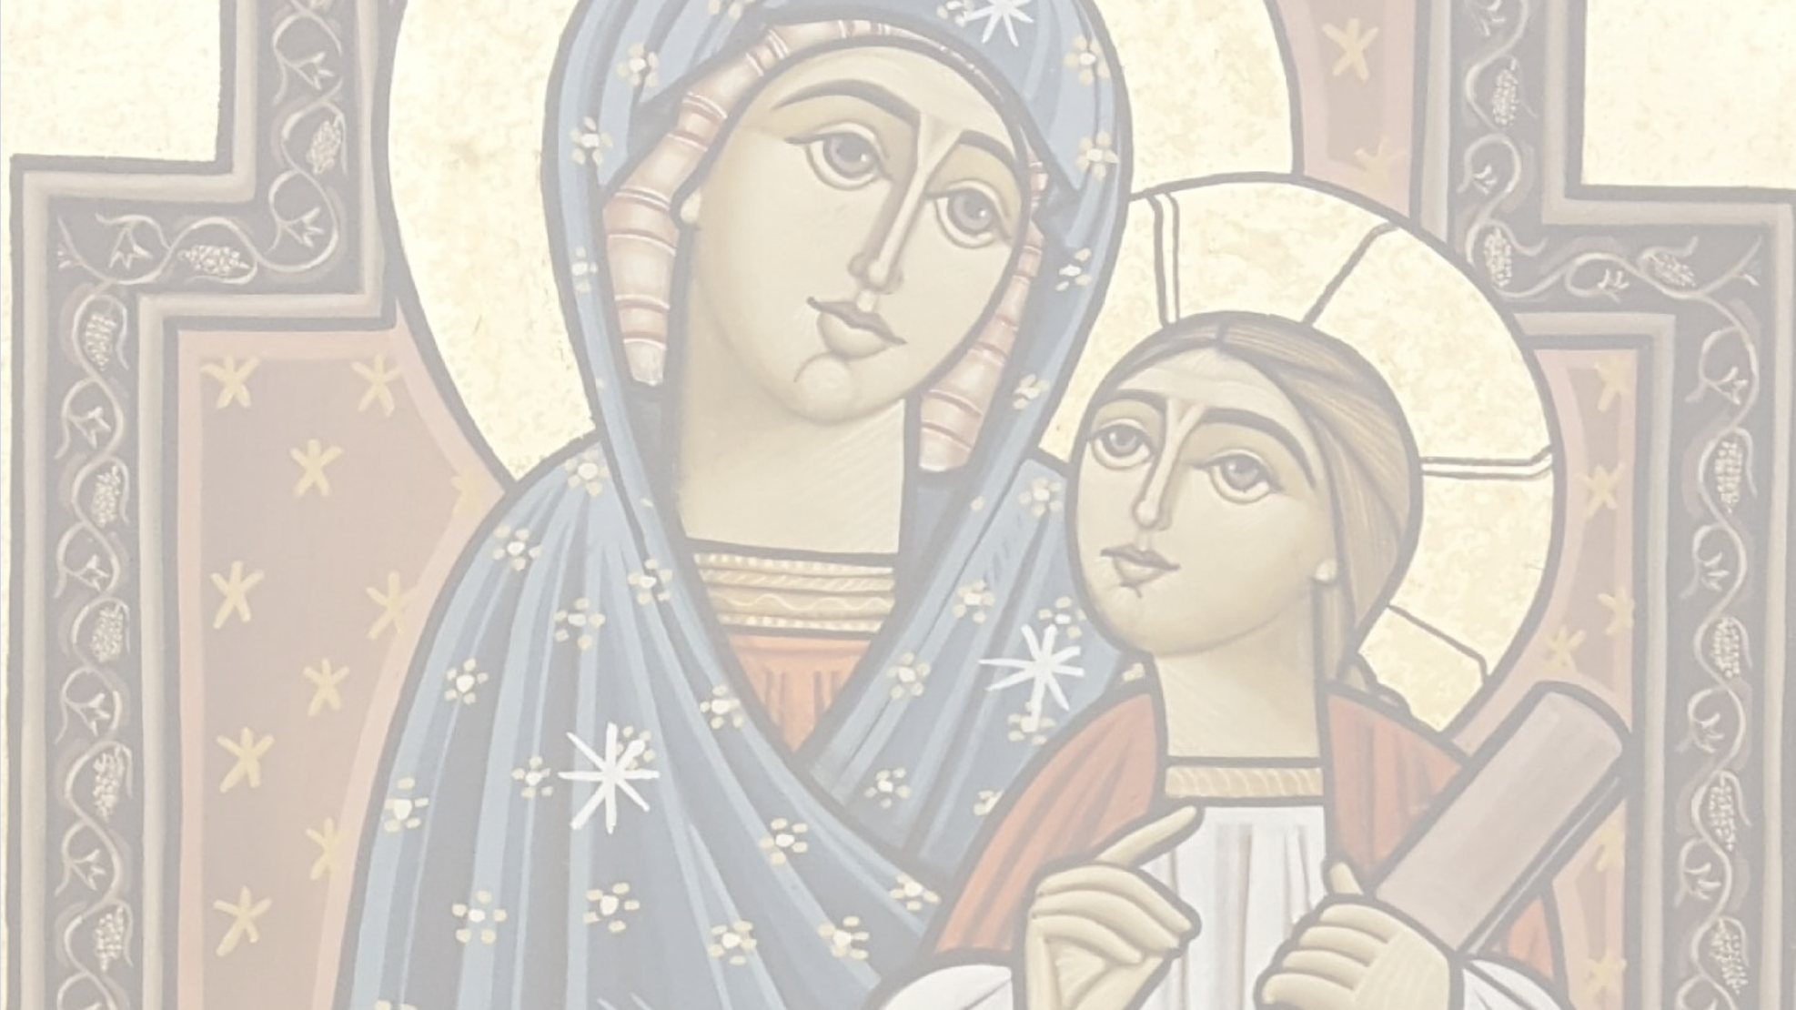
First Doxology for Koiahk
For indeed I will go,
to the house of David,
to acquire a voice,
by which I can speak of your honor.
Notes:
Reference from Psalm 45:9

Slide 3
First Doxology for Koiahk
For God has stood,
at the borders of Judea,
and joyfully granted His voice,
which the tribe of Judah accepted.

Slide 4
First Doxology for Koiahk
The tribe of Judah is the Virgin,
who gave birth to our Savior,
and after His birth,
she remained a virgin.
Notes:
Reference from Psalm 45:9

Slide 5
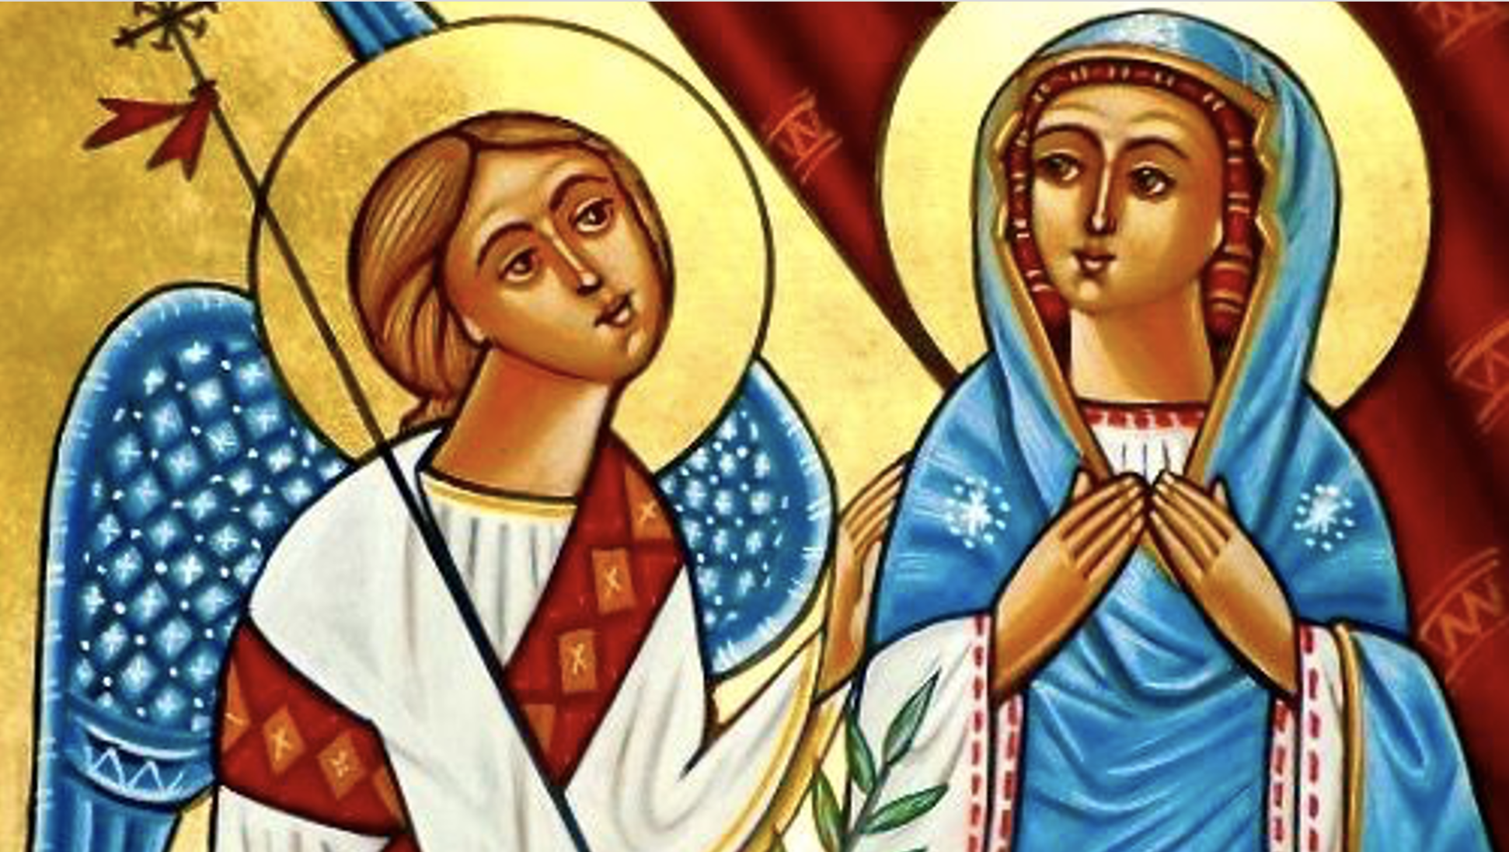
First Doxology for Koiahk
Along with the voice,
of Gabriel the angel,
we send you greetings,
O Mary the Mother of God.

Slide 6
First Doxology for Koiahk
Hail to you from God,
Hail to you from Gabriel,
Hail to you from us,
we magnify you, saying, “Hail to you.”
Notes:
Reference from Psalm 45:9

Slide 7
First Doxology for Koiahk
The holy angel Gabriel,
announced glad tidings to the Virgin,
and after the greeting,
he strengthened her, saying.

Slide 8
First Doxology for Koiahk
“Do not be afraid Mary,
for you have found favor with God,
behold, you shall conceive,
and bring forth a Son. “
Notes:
Reference from Psalm 45:9

Slide 9
First Doxology for Koiahk
“And the Lord God shall give Him,
the throne of His father David,
and He shall reign over the house of Jacob,
forever and ever.”

Slide 10
First Doxology for Koiahk
Therefore, at all times,
we glorify you as Theotokos,
ask the Lord on our behalf,
that He may forgive us our sins.
Notes:
Reference from Psalm 45:9

Slide 11
First Doxology for Koiahk
Hail to you, O Virgin,
the right and true Queen.
Hail to the pride of our race,
who bore to us Immanuel.

Slide 12
First Doxology for Koiahk
We ask you to remember us,
O our faithful advocate,
before our Lord Jesus Christ,
that He may forgive us our sins.
Notes:
Reference from Psalm 45:9

